Slide 1
Open-Source Intelligence (OSINT) Reconnaissance
Dr. John W. Carls, CISSP, C|EH

Slide 2
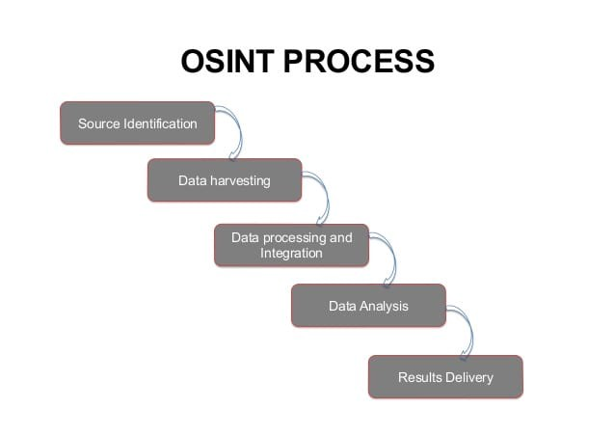
Open-source intelligence (OSINT)
Using publicly available sources to collect information (i.e., intelligence) about persons or entities from a wide array of sources
Usually performed during the Reconnaissance phase of hacking and pertinent information collected from this phase is carried over into the network Enumeration phase

Slide 3
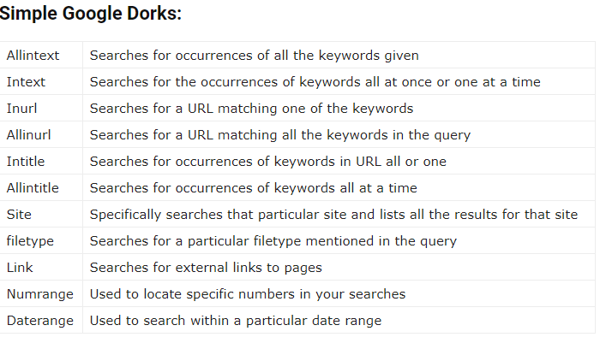
OSINT Tools
Google Searching & Dorking
Whois
Spokeo: People search engines crawl through social media sites, whitepages, email addresses, public records, criminal records, school records, and many other types of publicly available information sources
Shodan: Popular OSINT tool that is specifically designed for Internet-connected devices (i.e., including ICS, IoT, video game systems, and more)
Datasploit: Used to collect data on a particular domain, email, username, or phone number that you are targeting and then organizes the results coherently in HTML and JSON reports or text files. Datasploit will attempt to find credentials, api-keys, tokens, subdomains, domain history, legacy portals and more
Maltego: Analysis of real-world publicly available relational information. Footprint Internet infrastructure used on social networking sites and collect information about the people who use it. Query DNS records, whois records, search engines, social networks, various online APIs and extract metadata used to find correlational relationships between names, email addresses, aliases, groups, companies, organizations, Websites, domains, DNS names, Netblocks, IP addresses, affiliations, documents, and files

Slide 4
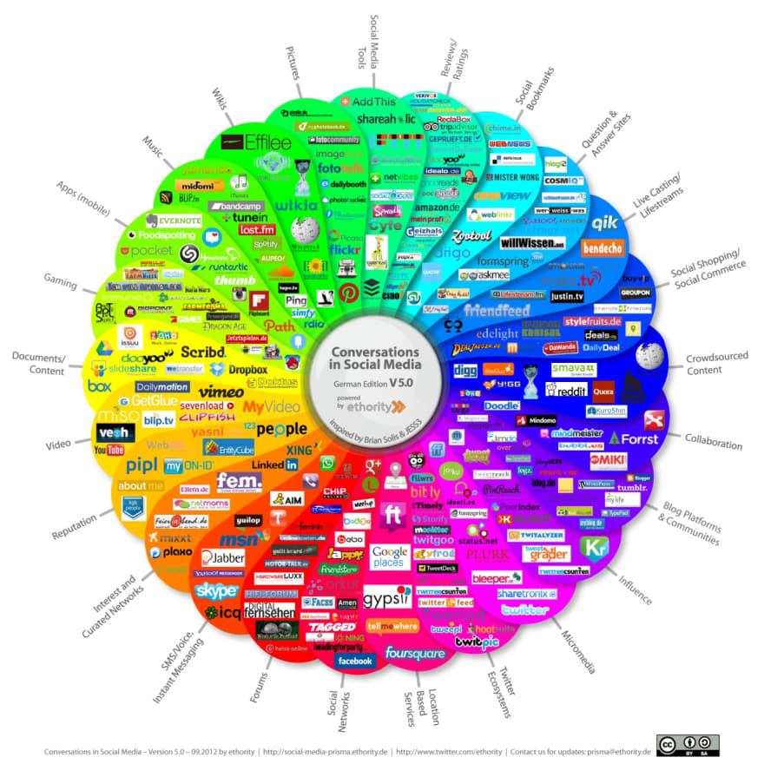

Slide 5
https://medium.com/@z3roTrust/open-source-intelligence-osint-reconnaissance-75edd7f7dada

